Slide 1

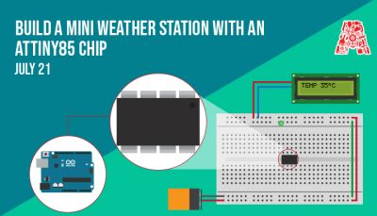
BUILD A MINI WEATHER STATION WITH AN ATTINY85 CHIP

Slide 2
About the Assembly
A smart lab based out of In5 since Dec 2014
Over 200 free workshops done
ASSEMBLY: HACK - Embedded systems, iOT and hardware
ASSEMBLY: CODE - Software projects - APIs, frameworks, apps
Age range: 16-60 - students, professionals, entrepreneurs
Focus on smart technology and practical applications
Forum: members.theassembly.ae

Slide 3
TAG US ON SOCIAL MEDIA!
FACEBOOK - The Assembly (@MakeSmartThings)
TWITTER - @MakeSmartThings
INSTAGRAM - @MakeSmartThings
YOUTUBE - The Assembly

Slide 4
Overview
1. Programs you need to install: Arduino IDE
2. Introduction to ATtiny and its various application
3. Bootloading ATtiny85
4. Simple LED example with the ATTiny85
5. Making a scaled down version of weather station
6. Working with temperature sensors and OLED screens

Slide 5
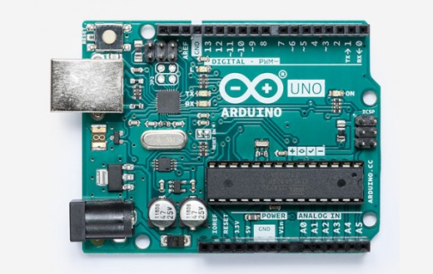
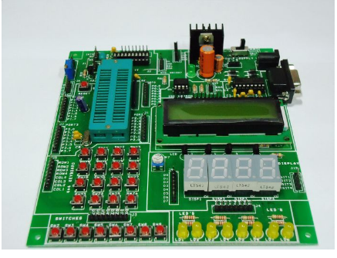
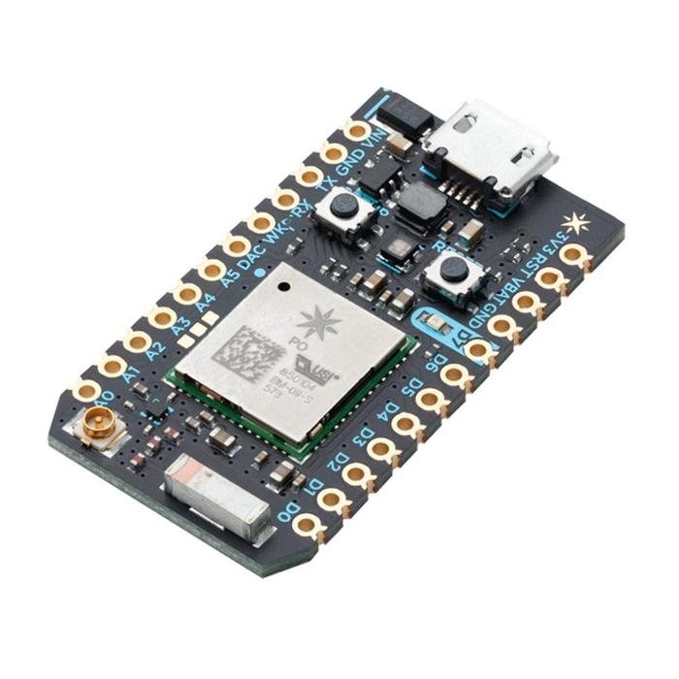
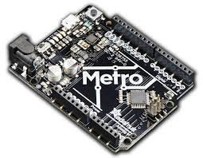
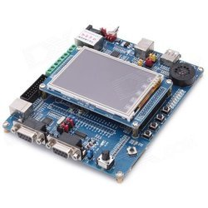
Why use ATtiny chips?

Slide 6
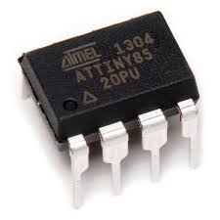
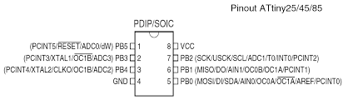
ATtiny85

Slide 7
Attiny85 vs Arduino UNO

Slide 8
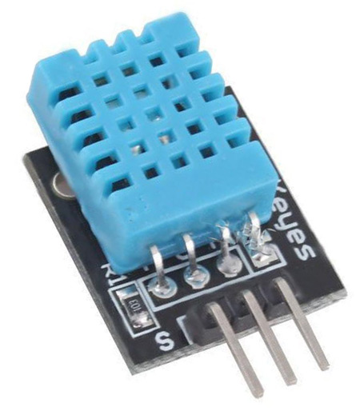
Temperature Sensor DHT11

Slide 9
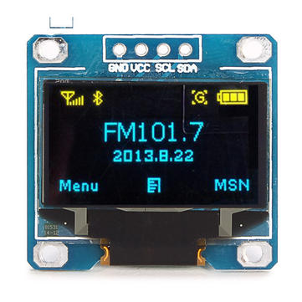
OLED screen display

Slide 10
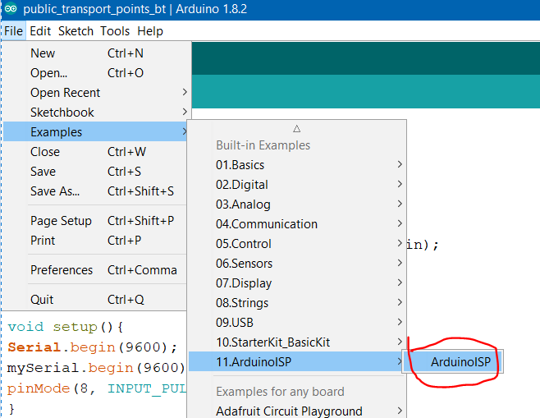
Live demo: Setup Bootloader
Open the Sketch “ArduinoISP” from the File, Examples and ArduinoISP menus.
Verify and upload this sketch to your Arduino

Slide 11
Live demo: Setup Bootloader
The Arduino software does not natively support the ATtiny85 so we need to add support for it.
Open the Preferences Dialog from the File menu.
Put https://raw.githubusercontent.com/damellis/attiny/ide-1.6.x-boards-manager/package_damellis_attiny_index.json into the "Additional Boards Manager URL".
Click OK!

Slide 12
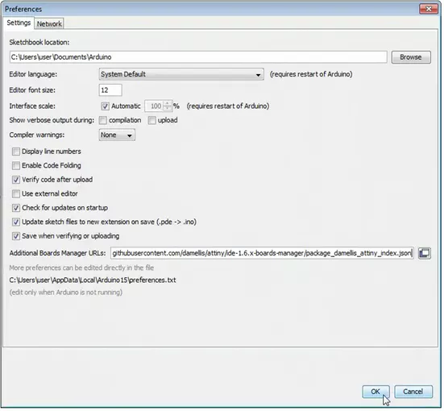

Slide 13
Live demo: Setup Bootloader
Open the Boards Manager from the Tools, Board Menus
Select the ATtiny from the list once the software has updated
Search for ATtiny, either manually scrolling down the list, or typing "attiny" in the filter field.
Click Install the (Use the latest version).
Install the following 2 libraries:
https://github.com/datacute/Tiny4kOLED
https://github.com/adafruit/TinyWireM

Slide 14
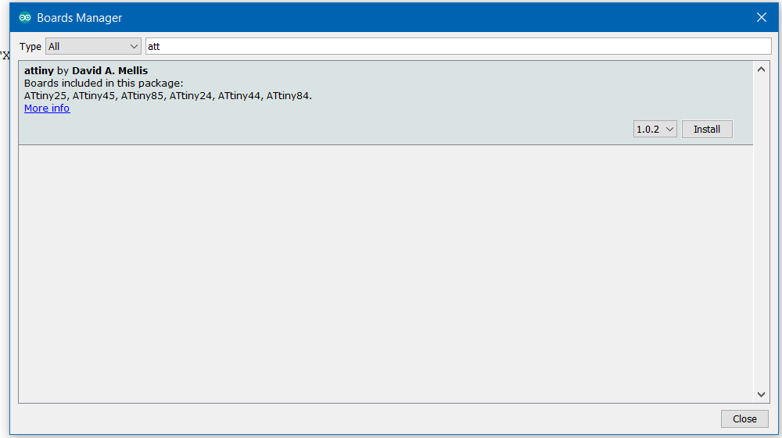

Slide 15
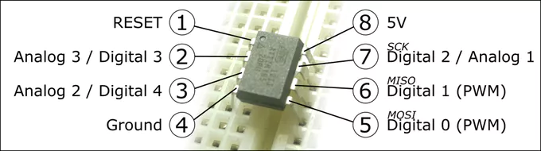
Program Setup
Program Setup
Let’s set up the program to use the Arduino as a programmer.
Select Arduino as ISP from the Tools, Programmer Menus
Select ATtiny from the Tools, Board Menus
Select ATtiny85 from the Tools, Processor Menus
Select 8Mhz Internal from the Tools, Clock Menu

Slide 16
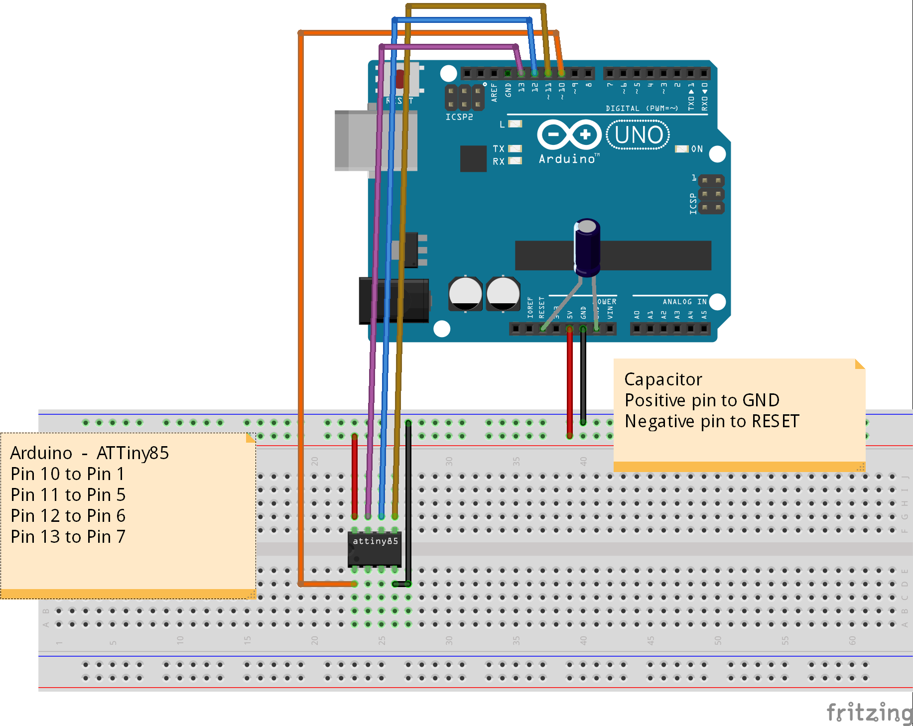

Slide 17
Hardware Setup
Unplug your Arduino
Place the ATtiny Chip onto the breadboard
Connect the ground from the Arduino to the Ground Rail
Connect the 5V from the Arduino to pin 8 of the ATTINY
Connect pin 4 of the chip to ground
Place the capacitor between ground and another terminal strip (The anode of the capacitor must be connected to ground)

Slide 18
Hardware Setup
Connect the cathode of the capacitor to the Reset pin of the Arduino
Connect a lead from the header pin 10 of the Arduino to pin 1 of the chip
Connect Arduino Pin 11 to Pin 5 of the chip
Connect Arduino Pin 12 to Pin 6 of the chip and
Connect Arduino Pin 13 to Pin 7 of the ATtiny85

Slide 19
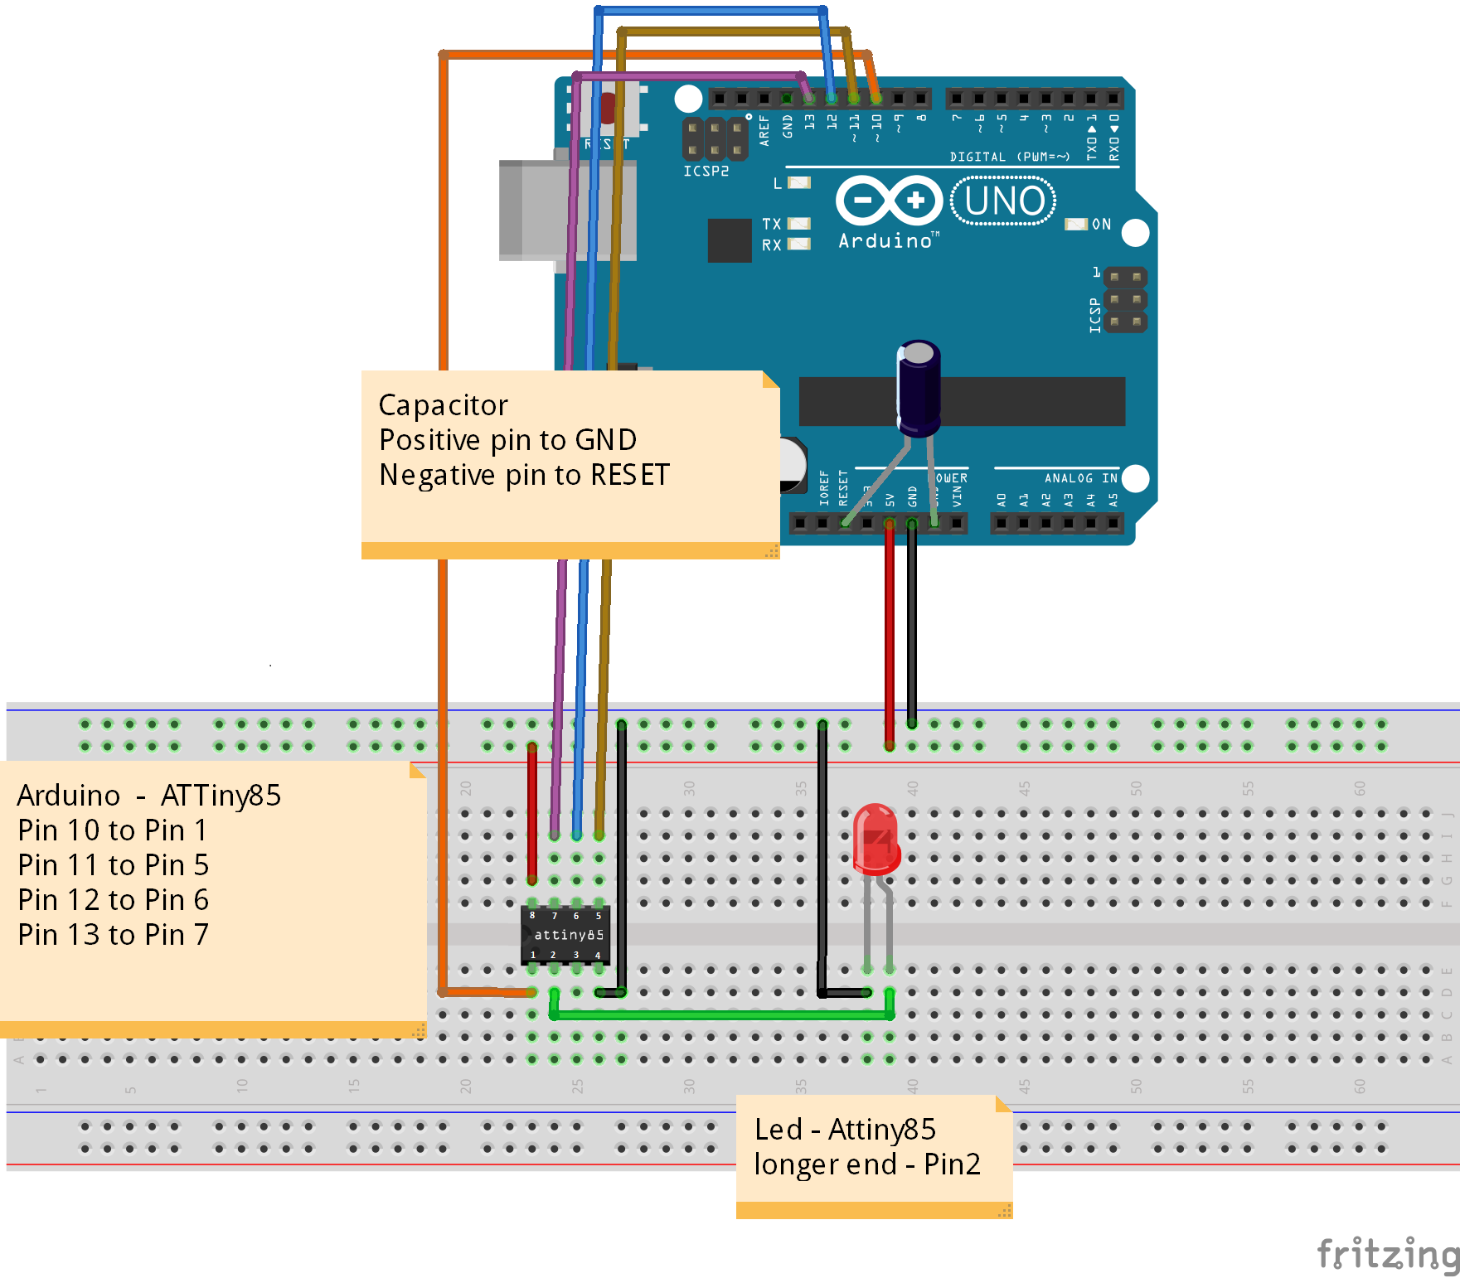

Slide 20
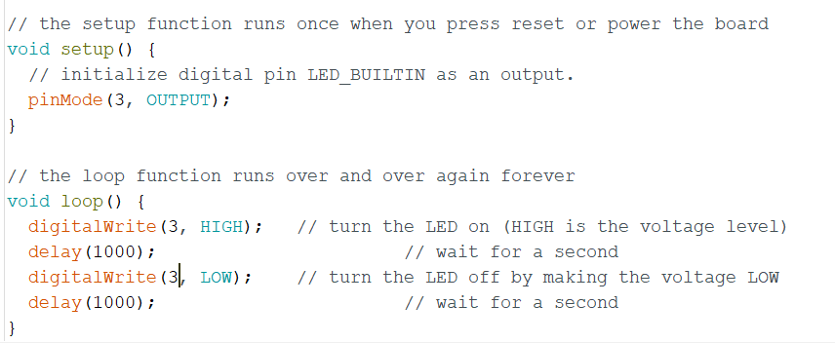
Burn the blink code to the Attiny85

Slide 21
Attach the OLED & DHT11
Connect SDA pin to 5
Connect SCL to pin 7
Connect VCC and GND to +5V and GND on power source
Attach the DHT to the pin 2 of Attiny.
Once that is done, you can upload Arduino Sketches to the ATtiny chip, as if it were an Arduino.

Slide 22
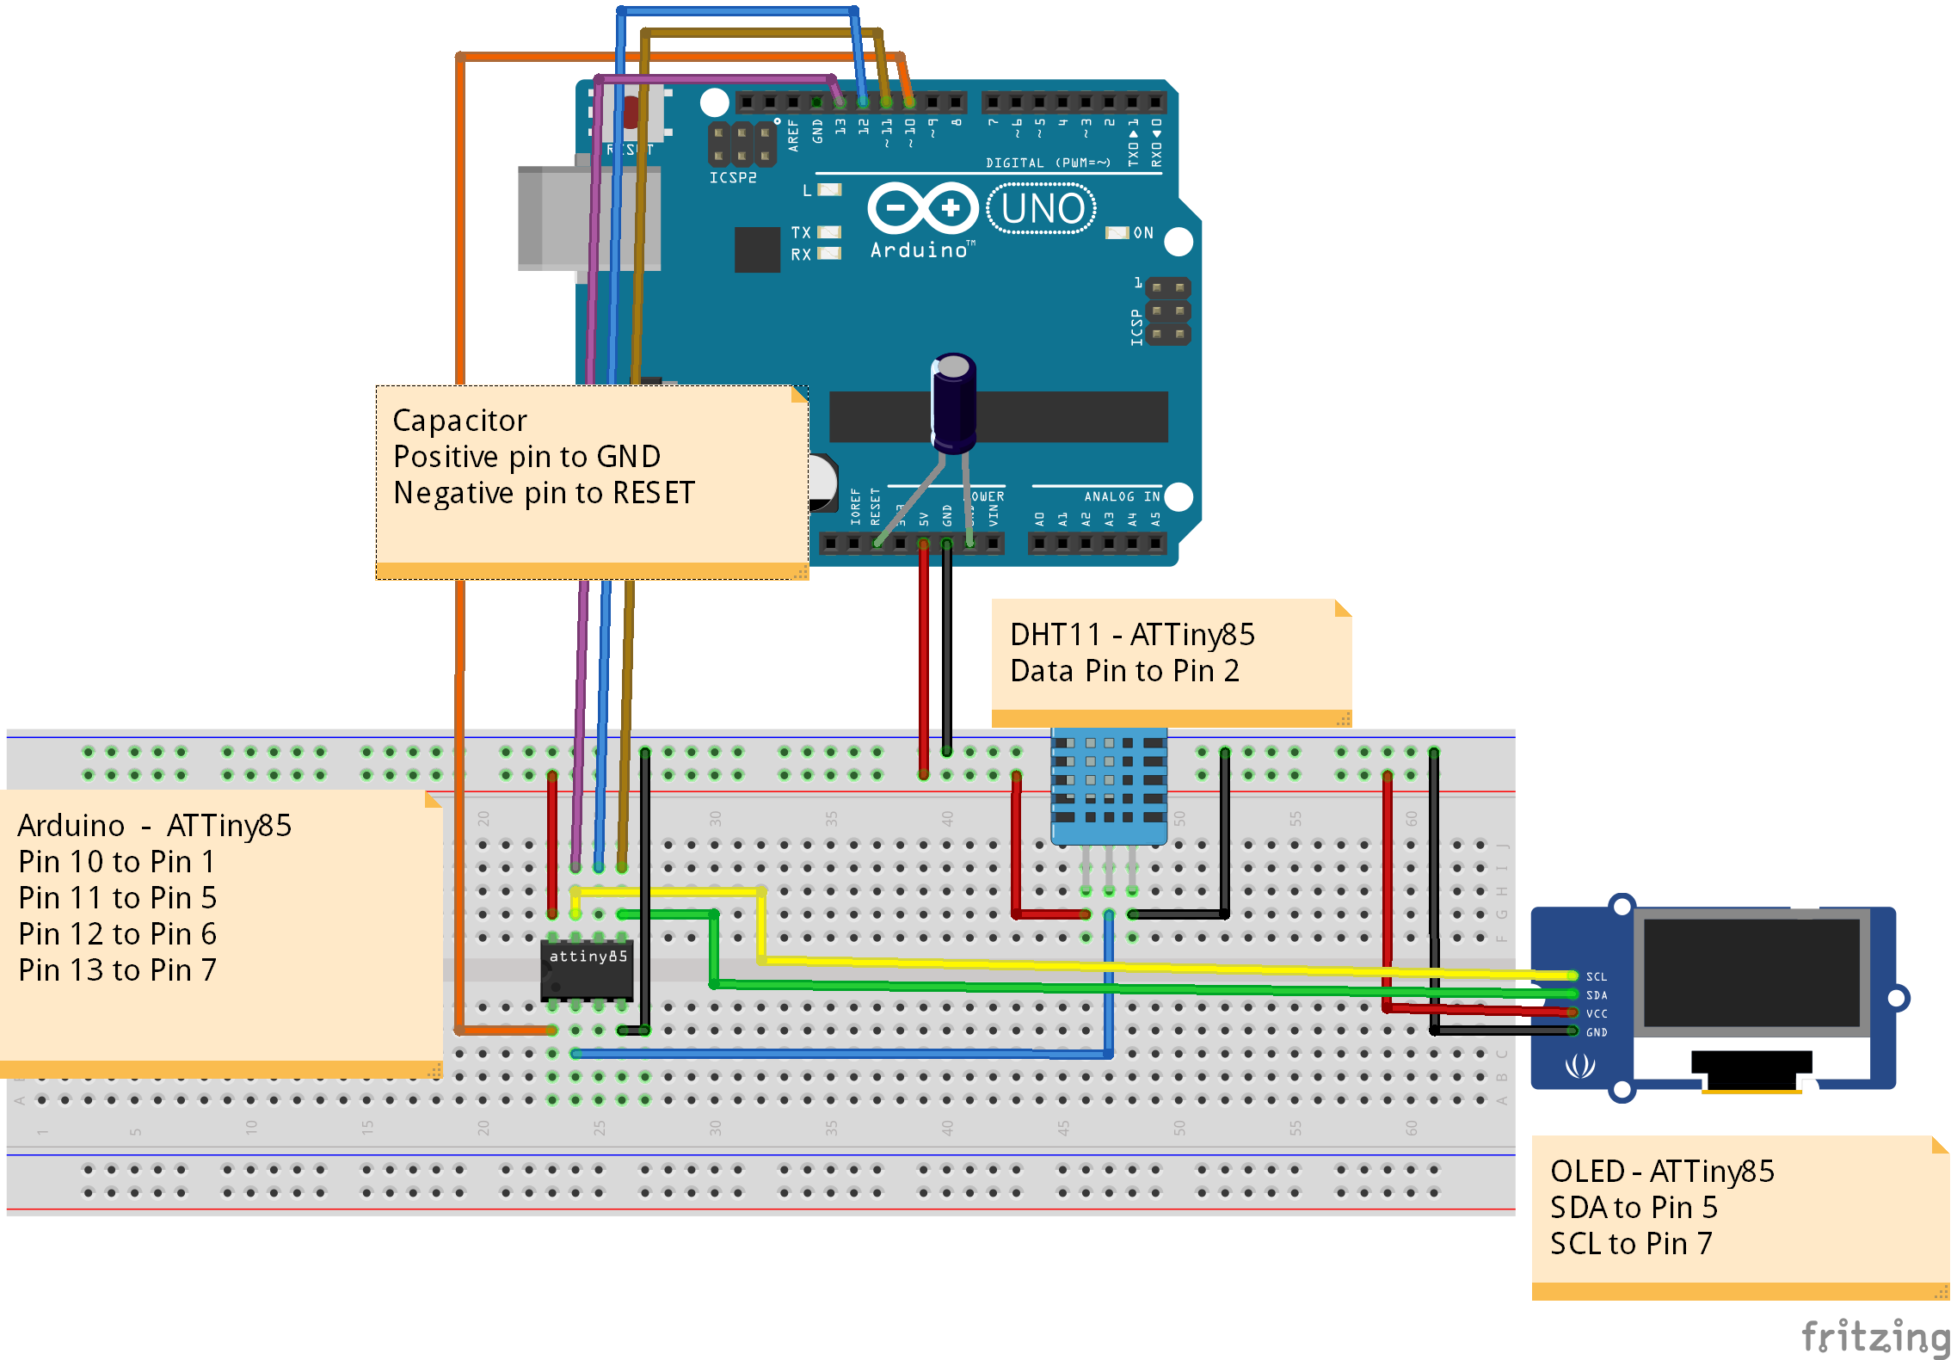

Slide 23
Add .zip libraries to your Arduino sketch
Go to https://github.com/The-Assembly/Weather
Download all the contents in the repository
Navigate to libraries folder and drag all the files onto Arduino libraries sub folder (My Documents\Arduino\libraries\)
Restart Arduino IDE

Slide 24
Libraries used
dht11 Library – this version of the library work properly with the current version of Arduino IDE, and is compatible with the ATtiny85 chip
Tiny4kOLED Library- Compatible with the SSD1306 OLED screen with 128X64 display. A derivation of another library, but works well with Attiny85 or similar microcontrollers.
TinyWireM Library – Extrapolated from the standard Arduino Wire.h library, used to enable I2C communication

Slide 25
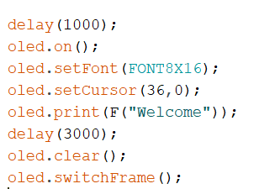
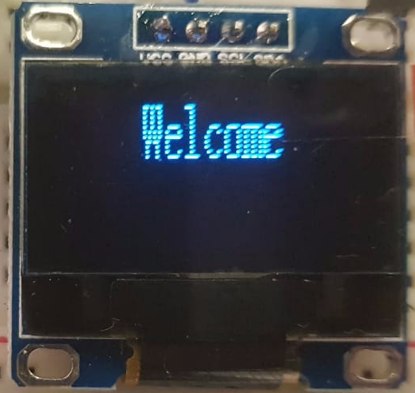
Welcome

Slide 26
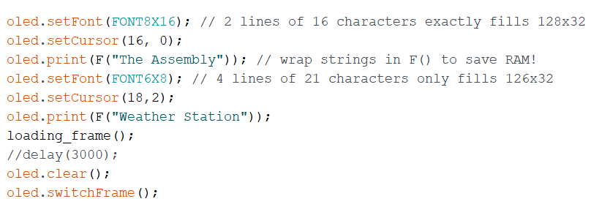
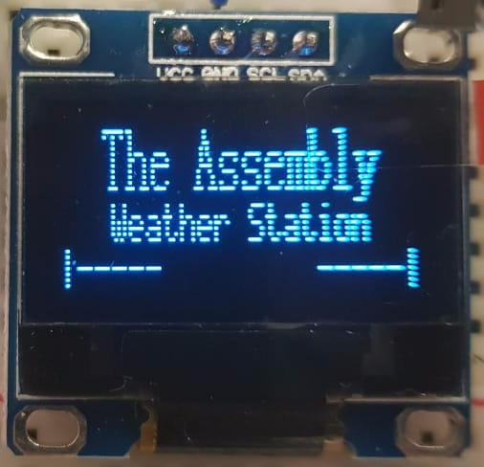
The Assembly Weather Station

Slide 27
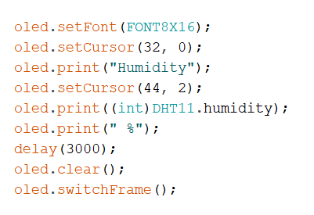
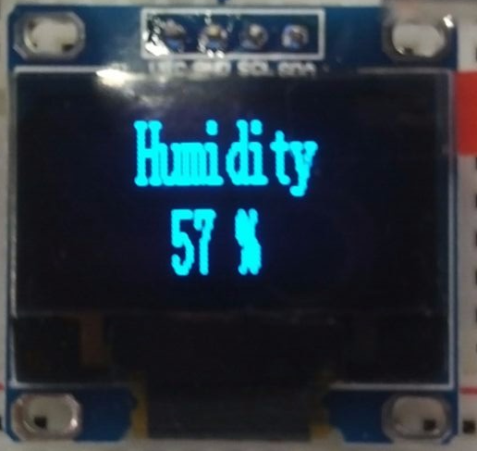
Humidity displayed on the OLED screen

Slide 28
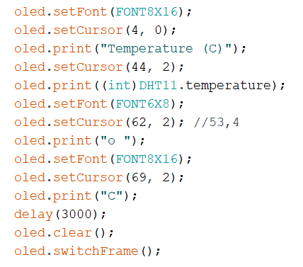
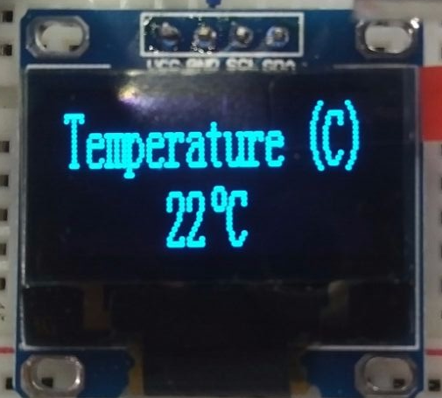
Temperature(°C) displayed on the OLED screen

Slide 29
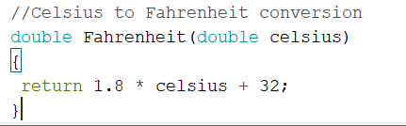
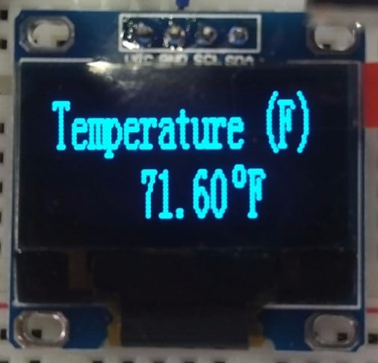
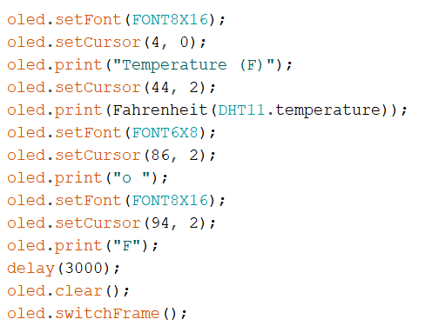
Temperature(°F) displayed on the OLED screen

Slide 30
Thank You!

